Slide 1


digiPACE
Claim Manager Guide

Slide 2
Table of content
Improvement Plans / Claims - DigiPACE
Accessing Claims
Process / Close - Claim & Tasks
Notes:
You don't speak about RFi, RFp but not sure we are using those types of RFx

Slide 3
Improvement Plans / Claims
Arcelor Mittal digiPACE online tool Can now be used to manage Claims.
Key Features:
Maintenance: Digital maintenance of all communication in one place.
Accountability: Assigned to responsible persons in both AM and Supplier side.
Accessibility: All communication happens in tool , accessible anytime.
Notifications: Provide instant notifications through email.
Common platform: Supplier & Claim manager use single platform.
Protection: Access restrictions based on org, commodity and Profile.

Slide 4
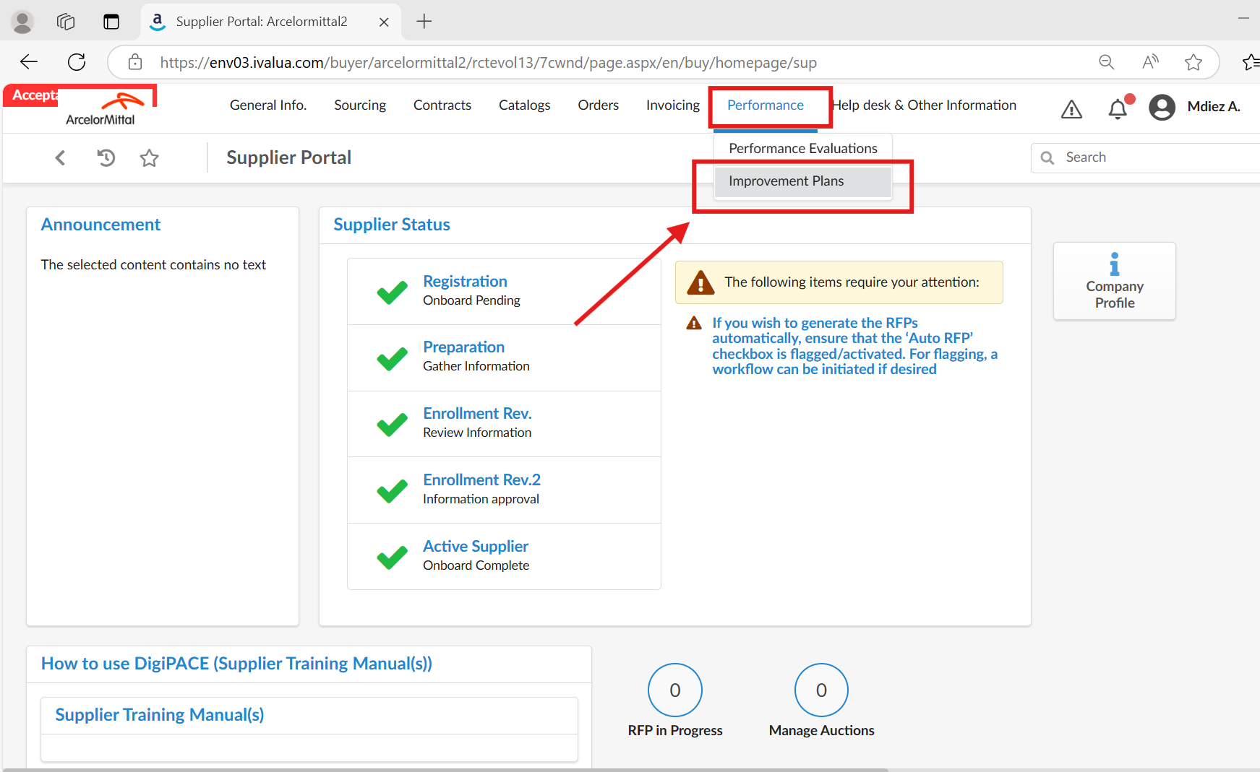
Accessing Claims
Login to digiPACE with user id & password in the below link:
https://digipace-suppliers.arcelormittal.com/page.aspx/en/usr/login
Click on Performance → Improvement Plans to access the Claims

Slide 5
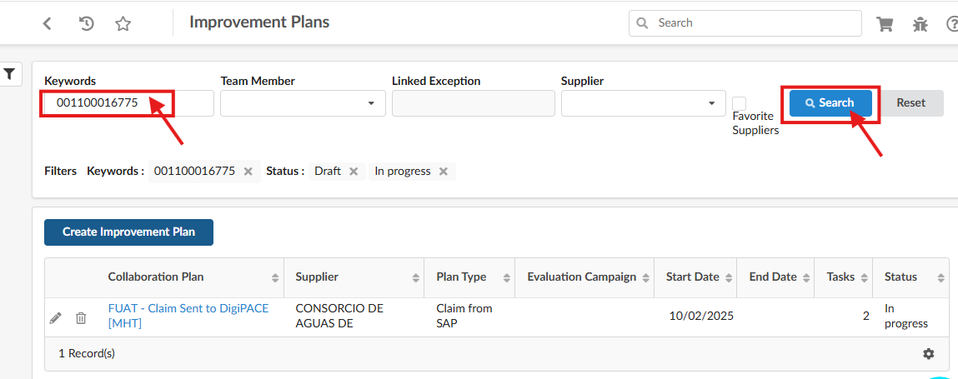
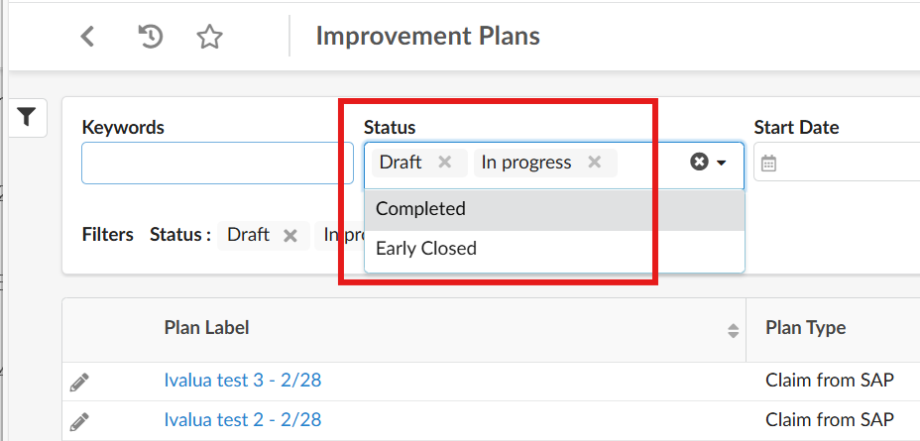
Accessing Claims
Enter Claim number received in email in the Keywords field
Click on Search button
Choose the required filter values
Search to display based on filter criteria

Slide 6
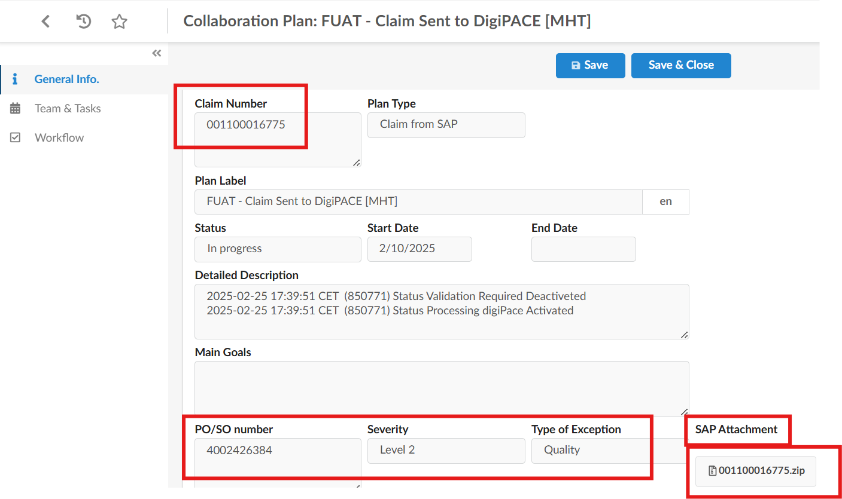
Accessing Claims
In the General info page all
the claim information is available.
Claim number
Severity
`PO/SO Number
Type of Exception
Status etc
Access the claim request Form in the Zip file in the SAP attachment
Claim status will be In Progress for ongoing claims
Claim status will be moved to Completed or Early Closed when all the tasks are closed and accepted by claim manager to close the Claim.

Slide 7
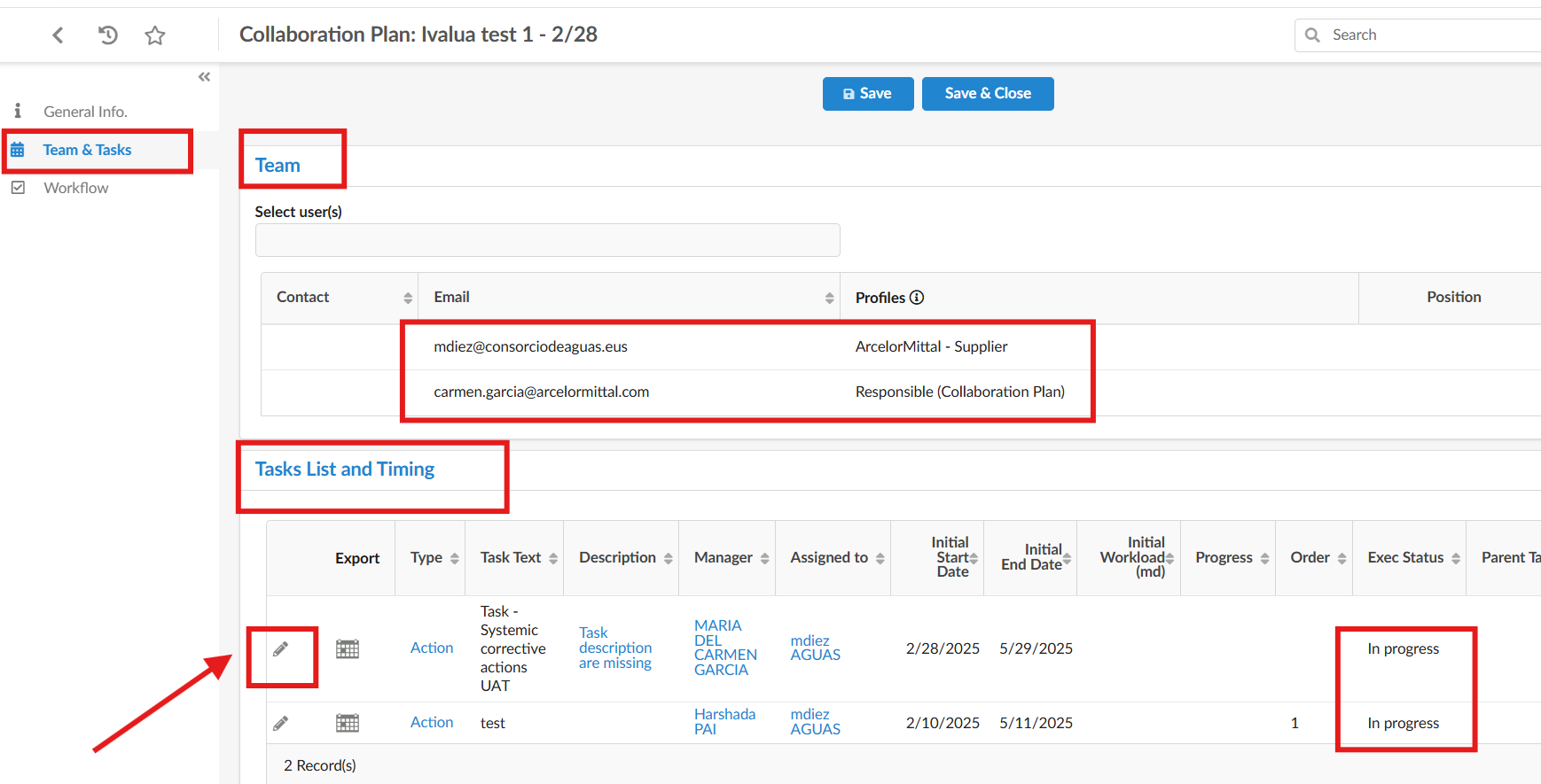
Process / Close - Claim & Tasks
In Team & Task under Team the responsible AM claim Manager and supplier contact person are shown.
Claim Manager is represented as Responsible Collaboration Plan .
Supplier contact person as Arcelormittal Supplier
The Tasks are listed in Tasks List assigned to either Supplier or Claim Manager.
Under Tasks click on the pencil icon to open the Task

Slide 8
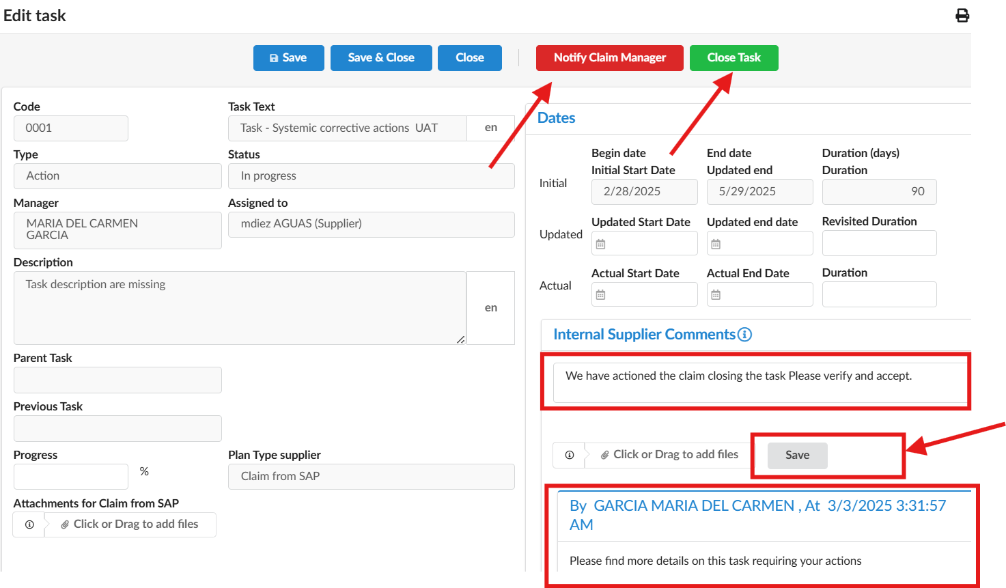
Process / Close - Claim & Tasks
Enter Comments and click on Save button to send any updates / queries to supplier .
Click on Notify Supplier to return the Task to Claim manager.(if you need clarifications to proceed)
Click on Close Task button when task is actioned 100% for claim Manager to review and agree to mark it Completed .
Task Status is changed to Close .
Once Claim manager accepts to complete the task the status changes to Done.

Slide 9

Thank you

